Slide 1
IT, Work, and
Workplace Privacy
CIS 150: Fundamentals of Information Systems

Slide 2
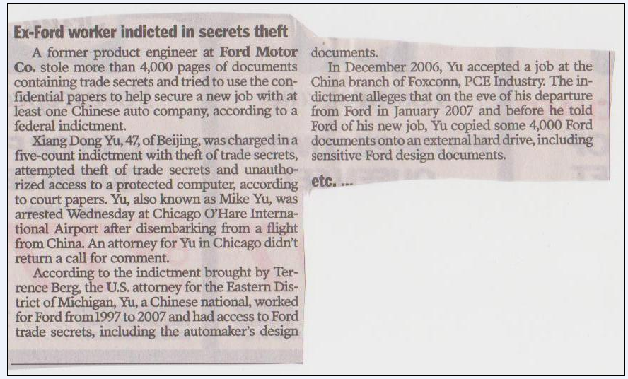
Trade Secrets
(Another Recent Example)
The Courier-Journal, Saturday, October 18, 2009, B9

Slide 3
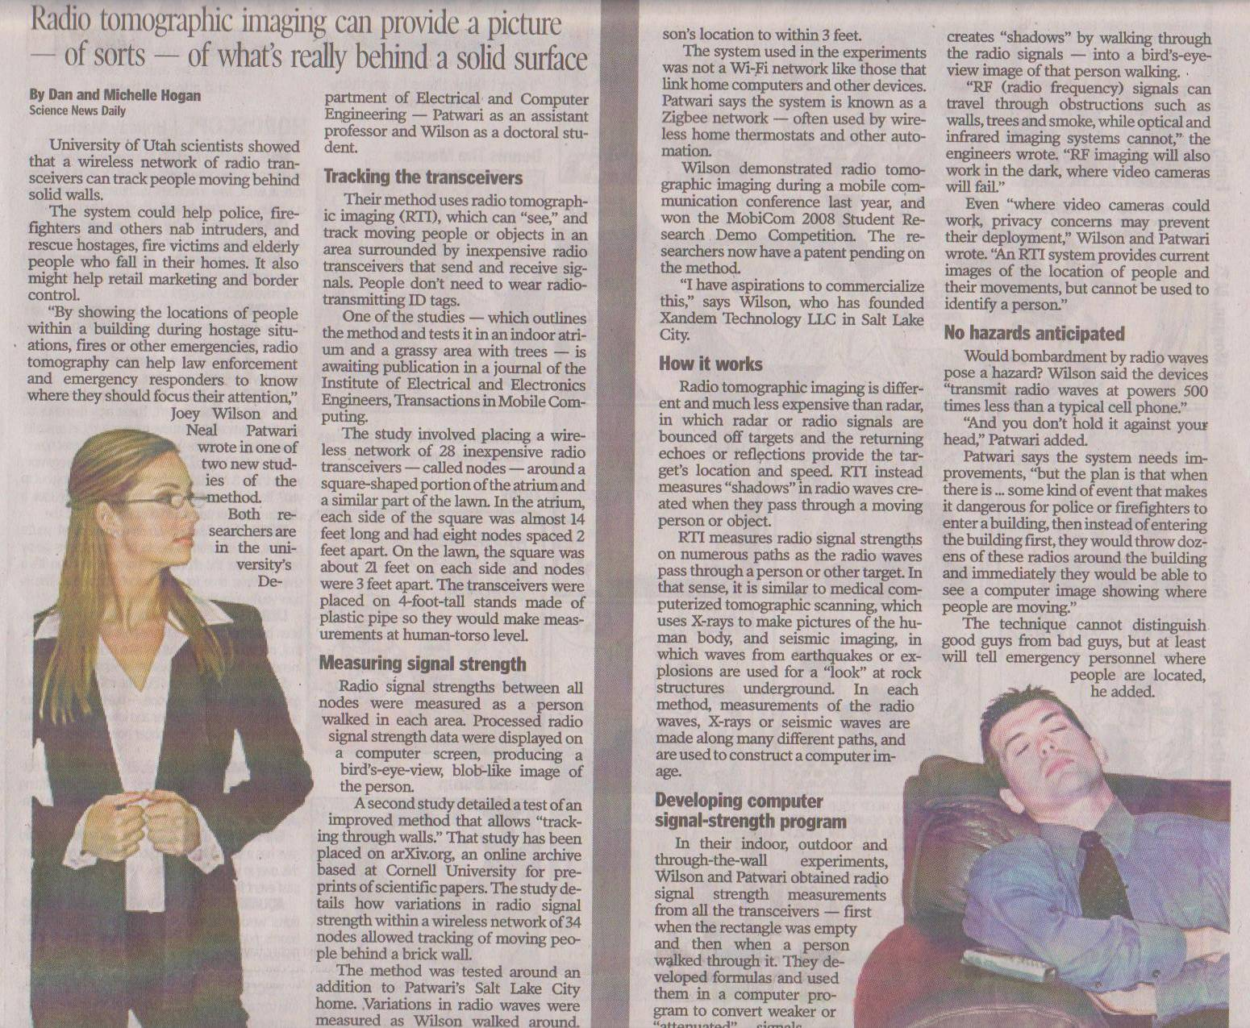
Privacy Invasive Technologies
(Hogan, D. and M., “System ‘sees’ through walls”, Courier Journal, 10/19/09, D3)

Slide 4
Last Class
Definition of information privacy?
Have we created a panopticon?
  The role of IT and privacy-invasive technologies
Fair Information Practices
  Notice, choice, integrity, access, and enforcement
Solutions
  Social norms-based solutions (privacy policies, consumer education)
    Allow the companies to self-regulate
  Technology-based solutions (encryption, cookies cutters, anonymizers, automated privacy audits)
  Market-based solutions (privacy policies, consumer demands)
  Legal protections (U.S. vs. Europe)
    Data Protection Directive → Directive 95/46/EC (Onward Transfer and the Safe Harbor Program)
    E-Privacy Directive → Directive 2002/58/EC

Slide 5
This Week
The impact of IT on employment
IT and a global workforce
  The truth about IT offshoring
  Getting an IT job
IT and the work environment
  Telecommuting
  Workplace privacy and information access
  Workplace monitoring
    Balancing the employer’s right to know vs. the employee’s right to privacy
    Laws
    Discuss the Spinello cases (5.4 and 5.5)

Slide 6
Impact of IT on Employment
IT and the destruction of jobs
  ATMs led to a 37% reduction in the # of bank tellers from 1983 - 1993
  Electronic calculators killed jobs related to the manufacturing of slide rules
  # of telephone switchboard operators fell from 421,000 in 1970 to 164,000 in 1996
  As utility companies installed electronic reading devices 35,000 electricity meter reading jobs were eliminated
  PCs eliminated jobs associated with building, selling, and repairing typewriters
  Online airline reservations led to the demise of travel agencies
  Digital cameras have put film processors out of work (e.g., Kodak initially eliminated 1,000 jobs in response to the success of digital cameras)
  Online music has put many music stores out of business (e.g., Tower Records in 2006)
  The Internet and self-service checkout systems have reduced the need for sales clerks
  Cell phones have led to a reduction in jobs in the wired telecommunications industry
Yes, IT does eliminate jobs! But…
  Successful IT leads to dramatic increases in productivity
    If you developed a cure for the common cold should you keep it secret to spare all of the jobs in the cold-medicine industry?
  Successful IT eliminates some jobs but creates others

Slide 7
Impact of IT on Employment
IT and the creation of jobs
  IT has changed the economics of industries
    Think about the development of the sewing machine
      A person could produce more than 2 shirts/day
      The increase in productivity along with the increase in supply → lower prices
      Lower prices → higher demand → hundreds of thousands of new jobs
    Reconsider ATMs → between 1996 and 2008 the # of tellers has increased from ~300,000 to ~600,000 (mostly due to banks opening more branches)
  IT has created new products, services, and entire industries
    Electronic spreadsheets (Visicalc), online auctions (e-Bay)
    IT development companies (e.g., Microsoft, IBM, Apple)
    IT consulting services (Booz Allen Hamilton, Deloitte Touche Tohmatsu, IBM Global Business Services, Ernst & Young)
    IT maintenance and IT support services
    Microprocessor industry (which did not exist before 1971)
    Social-networking sites, cell phone industry, digital music (DVD players, ipods, etc.)
    And so on…

Slide 8
Impact of IT on Employment
IT and the creation of jobs
  Data on the following slide comes from the Bureau of Labor Statistics (http://www.bls.gov/oes/2008/may/oes_nat.htm)
  The table presents May 2008 employment data for Computer Science Occupations (i.e., only includes IT jobs for computer specialists)
    Does not include self-employed workers or jobs
    Does not include other IT jobs in Office and Administrative Support Occupations
      ~ ½ million data entry keyers and word processors and typists
      >100,000 computer operators
      In 2004 it was estimated that >10.5 million people in the U.S. worked in IT jobs
    Does not include jobs created by IT in the areas of product design, manufacturing, marketing, sales, repair, and support staff like receptionists, janitors, etc.
    Does not include how Web sales have increased the number of jobs in the package shipping industry

Slide 9
Occupation Title (only include computer specialties) | Description | # in US Employed (2008)
Computer and Information Systems Managers (11-3021) | Plan, direct, or coordinate activities in such fields as electronic data processing, information systems, systems analysis, and computer programming. | 276,820
Computer and Information Scientists, Research (15-1011) | Conduct research into fundamental computer and information science as theorists, designers, or inventors. Solve or develop solutions to problems in the field of computer hardware and software. | 26,610
Computer Programmers (15-1021) | Convert project specifications and statements of problems and procedures to detailed logical flow charts for coding into computer language. Develop and write computer programs to store, locate, and retrieve specific documents, data, and information. May program web sites. | 394,230
Computer Software Engineers, Applications (15-1031) | Develop, create, and modify general computer applications software or specialized utility programs. Analyze user needs and develop software solutions. Design software or customize software for client use with the aim of optimizing operational efficiency. May analyze and design databases within an application area, working individually or coordinating database development as part of a team. | 494,160
Computer Software Engineers, Systems Software (15-1032) | Research, design, develop, and test operating systems-level software, compilers, and network distribution software for medical, industrial, military, communications, aerospace, business, scientific, and general computing applications. Set operational specifications and formulate and analyze software requirements. Apply principles and techniques of computer science, engineering, and mathematical analysis. | 381,830
Computer Support Specialists (15-1041) | Provide technical assistance to computer system users. Answer questions or resolve computer problems for clients in person, via telephone or from remote location. May provide assistance concerning the use of computer hardware and software, including printing, installation, word processing, electronic mail, and operating systems. | 545,520
Computer Systems Analysts (15-1051) | Analyze science, engineering, business, and all other data processing problems for application to electronic data processing systems. Analyze user requirements, procedures, and problems to automate or improve existing systems and review computer system capabilities, workflow, and scheduling limitations. May analyze or recommend commercially available software. May supervise computer programmers. | 489,890
Database Administrators (15-1061) | Coordinate changes to computer databases, test and implement the database applying knowledge of database management systems. May plan, coordinate, and implement security measures to safeguard computer databases. | 115,770
Network and Computer Systems Administrators (15-1071) | Install, configure, and support an organization's local area network (LAN), wide area network (WAN), and Internet system or a segment of a network system. Maintain network hardware and software. Monitor network to ensure network availability to all system users and perform necessary maintenance to support network availability. May supervise other network support and client server specialists and plan, coordinate, and implement network security measures. | 327,850
Network Systems and Data Communications Analysts (15-1081) | Analyze, design, test, and evaluate network systems, such as local area networks (LAN), wide area networks (WAN), Internet, intranet, and other data communications systems. Perform network modeling, analysis, and planning. Research and recommend network and data communications hardware and software. Include telecommunications specialists who deal with the interfacing of computer and communications equipment. May supervise computer programmers. | 230,410
Computer Specialists, All Other (15-1099) | All computer specialists not listed separately. | 191,780
Total |  | 3,474,870

Slide 10
Impact of IT on Employment
According to the BLS, IT occupations make up five (5) of the 25 fastest growing occupations in the U.S. (2006-2016)
  1. Network systems and data communications analysts
  4. Computer software engineers, applications
  23. Computer systems analysts
  24. Database administrators
  25. Computer software engineers, systems software

Slide 11
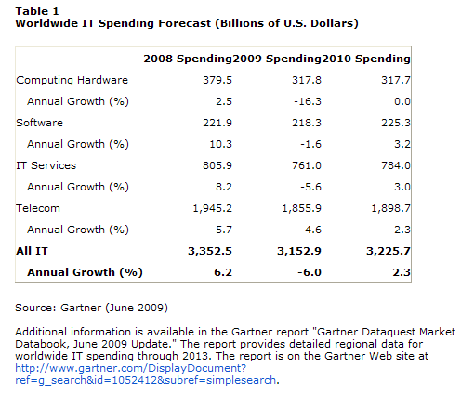
Impact of IT on Employment
Worldwide IT Spending ~ $3.2 trillion
  That creates a lot of jobs worldwide
So what is the net effect of IT on jobs?

Slide 12
Impact of IT on Employment
New jobs created by IT are different from jobs eliminated by IT
  IT created jobs often require a college degree
    Systems analysts, computer programmers, database administrators, network administrators, etc.
  IT destroyed jobs often may not require a college degree
    Bank tellers, customer service representative, phone operators, electricity meter readers, sales clerks, etc.

Slide 13
IT and a Global Workforce
IT offshoring
  Hiring companies/employees in other countries to provide products or services
    As transportation and communications cost improved, manufacturing jobs moved from wealthier countries to less wealthy countries (especially India, China, Brazil, and Canada) where pay rates are historically much lower
    More recently, the internet/Web has significantly reduced the “transportation” costs for many kinds of information work
      Data processing, customer service, and computer programming were among the 1st service jobs to go offshore (mostly to India)
        India has a large pool of low-skilled workers (for data processing) and a large pool of well-trained, English-speaking computer programmers
        India also has lower wages (but the disparity is decreasing – used to be 25% of US wages, now is about 75%)
    By 2004, ~12% of U.S. IT companies moved some of their operations offshore
      Customer service call centers, software help desks, back-office jobs (e.g., payroll processing)
      Doctors in US dictate notes on patient visits, send digitized voice files to India where medical scribes transcribe them and return the text files

Slide 14
IT and a Global Workforce
IT offshoring
  2005
    Offshoring of skilled work (i.e., knowledge work) increased, leading to more worries about the threat of job losses (especially high-paying jobs)
      Marketing, research (e.g., pharmaceutical and biotech), legal services, stock analysis, and other financial services
  2009 → < 5% of IT jobs are offshored
  Important: In some fields (e.g., computer science) one important reason for offshoring is that there are not enough trained professionals in the US
    Late 1990s/early 2000s → “dot-com bust”
      Enrollment in Computer Science (CS) and CIS programs dropped significantly
        University of Arizona (top 5 CIS program): from about ~200 CIS majors to ~25 majors in 3 years
        UNLV: from ~300 CIS majors to ~50 majors in 4 years
        University of Minnesota and UT Austin (both top 5 CIS programs): CIS faculty were forced to teach Accounting courses due to lack of CIS majors

Slide 15
IT and a Global Workforce
IT offshoring
  Important: In some fields (e.g., computer science) one important reason for offshoring is that there are not enough trained professionals in the US
    While enrollment in CS and CIS majors dropped dramatically in the early 2000s (following the “dot-com bust”) the demand for computer and network specialists remained very high
    So where did companies turn to fill positions? They went offshore
    As some of these high-skill information jobs began moving offshore, more people became worried about CS and CIS as a major, leading to further reductions in CS/CIS enrollments and a further reduction in a skilled domestic workforce to fill IT jobs
  The end result
    It is important to look at not only the offshoring trend, but also the reason for the trend
    According to the BLS IT occupations make up five (5) of the 25 fastest growing occupations in the U.S. (2006-2016)
    The demand for your skills continues to grow!
    There are not enough of you to satisfy the needs of our employers!

Slide 16
IT and Getting a Job
The Internet has made the process of finding information about jobs and employers much easier
  Jobster.com
  Monster.com
  Yahoo!HotJobs
Note: Employers also use the internet to learn about applicants and employees
  Many search blogs and social networking sites
    Make sure to clean up your online material before you put in a job application
  Many use huge data collection companies (e.g., ChoicePoint) to perform background checks

Slide 17
Workplace Monitoring
Employers monitor workers to:
  Ensure that corporate IT usage policy is followed
  Evaluate worker performance
  Ensure safe and comfortable work environment
Fourth Amendment cannot be used to limit how a private employer treats its employees
  Public-sector employees have far greater privacy rights than in the private industry
Privacy advocates and Unions want federal legislation
  To keep employers from infringing upon privacy rights of employees

Slide 18
What is Different?
Traditional monitoring was:
  Periodic
  Less detailed
  Typically seen by workers
  Affected “blue collar” (factory) and “pink collar” (telephone and clerical) workers
Electronic monitoring can be:
  Constant
  More detailed
  Unseen by workers
  Also affects “white collar” (professional)

Slide 19
Electronic Monitoring (EM)
What is it?
How is it done?
Arguments in favor of EM
Criticisms of EM
Legal considerations
Management guidelines

Slide 20
Types of Electronic Monitoring
Phone monitoring
Keystroke loggers
Internet monitoring and filtering, e-mail monitoring, instant message monitoring
  Packet-sniffing software (Silent Watch)
Location monitoring
  “Smart” ID cards, global positioning systems (GPS)
Personality and psychological testing, drug testing, intelligence testing, genetic testing, etc.
Closed-circuit video monitoring

Slide 21
Phone Monitoring
Can my employer listen to my phone calls at work?
  Unannounced monitoring for business-related calls? Yes (Electronic Communications Privacy Act)
  Personal calls? No (Watkins v. L.M. Berry & Co., 1983)
  Headset conversations with co-workers? Yes
Can my employer obtain a record of my phone calls?
  Yes (pen register)
What about my employer's promises regarding workplace privacy issues. Are they legally binding?
  Generally, yes.
  Exception: investigations for wrong-doing
Used to measure employee performance

Slide 22
Keystroke Monitoring
Is my employer allowed to see what is on my terminal while I am working?
  Generally, yes.
  Since the employer owns the computer network and the terminals, she is free to use them to monitor employees
  Law favors employer property rights over employee privacy rights
Used to measure employee performance, uncover employee crimes, and protect the work environment

Slide 23
Keystroke Monitoring
The Case of Newport Electronics (fictitious)
  Julie is a great salesperson just promoted
  Her friend is a secretary in marketing who was fired for a relationship with an executive
  Julie sat at her computer and wrote a nasty letter:
  “I am writing to protest your recent handling of the Patricia C. situation. She has been shabbily treated in a one-sided and sexist decision making process. You should be ashamed of your conduct in this matter. How can you justify firing her and letting Mr. X remain in his position… ”
  She then decided to stop the letter, did not send it, and deleted it.
  The company had installed a keystroke monitoring software – iNVESTIGATE – that tracks all keystrokes
  She was fired
  She sued – said that Newport Electronics said all computers activities were monitored but it did not say every keystroke (even deletions) were monitored
  Has Julie been treated fairly? Why or why not? Is this a case of “wrongful termination”? Is iNVESTIGATE unethical? Can this be used responsibly?

Slide 24
Location Monitoring
Nurses
  Smart IDs
Companies with fleets of vehicles
  Late 1980s - satellite tracking systems on long-haul trucks to track location, rate of speed, length of rests, when driver turns on headlights
    Benefits:
      Better planning of deliveries
      Don’t waste time at public phones to check in
      Communication about schedule changes, traffic and weather conditions
      Data on speed and rest stops improves safety
      Trucks with valuable goods are target for theft and more easily found (100s of stolen trucks found cause thieves didn’t know about tracking devices)
      Reduces insurance rates, overtime costs, workers’ compensation
    Problems
      Truckers see it as Big Brother and an invasion of privacy
      Wrapped foil over the device transistors or took rest stops under bridges
  Would it be as good to use cell phones and wireless email as opposed to tracking devices and GPS? Is that overkill for the purpose?

Slide 25
Email and Internet Monitoring
Is electronic mail private? What about voice mail?
  Generally, no
    Incoming and outgoing emails, personal accounts like yahoo or hotmail
  Property rights over privacy rights
  No expectation of privacy
  Workplace privacy court cases in the employer's favor
    Smyth v. Pillsbury, www.loundy.com/CASES/Smyth_v_Pillsbury.html
When I delete messages from my terminal, are they still in the system?
  Yes
My employer's electronic mail system has an option for marking messages as "private." Are those messages protected?
  In most cases, no

Slide 26
Email and Internet Monitoring
Reasons to monitor email, web surfing, computer files
  Find needed business information in an employee’s messages or files when the employee is not available
  Protect security of proprietary information and data (e.g., monitor participation in blogs to make sure no derogatory comments about company or release of trade secrets)
  Prevent or investigate possible criminal activities by employees (running betting pools)
  Prevent personal use of employer facilities, if prohibited by company policy (running a personal website)
  Check for violations of company policy against sending offensive or pornographic email (questionable jokes) – prevent “hostile workplace environment”
  Investigate complaints of harassment
  Check for illegal software

Slide 27
U.S. Workplace Privacy Laws
Few laws
Electronic Communications Privacy Act of 1986 (ECPA)
  Firm property rights over privacy rights
  Exception: cannot eavesdrop on personal phone calls but employers can get around this by getting worker consent
  EM for purposes discussed in earlier slides is basically legal
To win in courts, worker must show “expectation of privacy”?
  Very difficult to do in a court of law
  Locker example and the Microsoft case

Slide 28
European Workplace Privacy Laws
More comprehensive
Protecting human dignity
France (Article 120-2 of France’s Labor Law)
  Employer must inform worker in advance of any surveillance
Italy (Italian Worker’s Statute)
  Prohibits remote surveillance of workers by video camera and other devices unless agreed to by the union for the sake of a business necessity
  The worker may still challenge the surveillance
  Can’t install software to monitor a worker’s performance

Slide 29
Arguments in Favor of EM
Employers always have the broad rights of observation and record keeping of employees performance, EM is just an extension of those rights.
EM helps to increase productivity
EM gives more accurate cost accounting
EM improves management of people
  No bias
  Fair performance expectations
  Improves performance appraisal
  Provides data quickly and frequently

Slide 30
Criticisms of EM
EM is an invasion of employee privacy
The monitoring is continuous:
  Everything an employee does, from regular work to toilet breaks, is timed to the second
Employees have no control over, or knowledge of, when and how monitoring takes place

Slide 31
More Criticisms of EM
EM erodes trust and loyalty between employees and employer
EM increases stress on the employees and leads to stress-related health problems
  What are the implications for health costs to the firm?
EM leads to management expectation of:
  A machine-established work pace
  Excess production quotas
  Work speedups

Slide 32
And Even More Criticisms
EM leads to over-dependence on quantifiable data as a measure of employee performance, eliminating softer, qualitative aspects of a job.
EM can result in:
  Lower morale
  Increased turnover and absenteeism
  Consequent poor customer service

Slide 33
Moral and Legal Considerations
Employee hostility and unhappiness may result from non-involvement in the design and implementation of such systems. A sense of unfairness results.
Fairness involves:
  The work standards
  The measurement process
  The methods used to evaluate employees

Slide 34
Guidelines for Management
Establish a clear and detailed monitoring policy
Seek worker involvement
  Explain why an EM system is necessary
  Explain how employees can benefit from an EM system
  Involve employees in the planning and design of the EM system
  Form a quality circle with the employees to provide feedback to management

Slide 35
Guidelines for Management
Decide what information is really needed
  Explain to employees why that information is needed
  Eliminate the “more is better” mentality
  Only collect data necessary for the stated purpose
    Consider the use of GPS for long-haul trucker vs. use of cell phones or wireless email
  Give workers the respect and privacy they deserve

Slide 36
Guidelines for Management
Employee notification - when, how
Only business calls can be monitored, not personal calls. Employers should provide unmonitored telephones for personal calls
Strive for fairness and provide data access
  Employees whose performance has been criticized should have access to monitoring data and an opportunity to challenge the evaluation (access and resolution mechanism)
Implement a reward-for-performance policy
Provide supervisory training on performance feedback
Provide feedback to improve employee performance

Slide 37
Conclusions
The appeal of EM will increase with the continued use of computers
Management perceives EM will contribute to productivity
Management must balance conflicting perceptions and objectives

Slide 38
Summary
The impact of IT on employment
IT and a global workforce
  The truth about IT offshoring
  Getting an IT job
IT and the work environment
  Telecommuting
  Workplace privacy and information access
  Workplace monitoring
    Balancing the employer’s right to know vs. the employee’s right to privacy
    Laws
    Discuss the Spinello cases (5.4 and 5.5)

